Slide 1

Biological Modeling
A Short Tour
Phillip Compeau
Notes:
front_cover

Slide 2
Biological Modeling
A Short Tour
Phillip Compeau
Notes:
front_cover_9_by_6

Slide 3

Join us for a tour of biological modeling
Biological Modeling: A Short Tour offers readers a deep but concise exploration of topics in modeling biological systems at multiple scales of resolution, from the molecular to the cellular.
Each chapter asks a single biological question, from why zebras have stripes, to how bacteria explore their world intelligently, to why the SARS-CoV-2 spike protein was so effective at binding to human cells. It then introduces topics in biological modeling needed to answer these questions.
The book website (biologicalmodeling.org) provides a free online course containing dozens of interactive tutorials allowing readers to build and explore the models introduced in this book. The course was produced because of the hard work of talented students at Carnegie Mellon University, and these students appear as chapter co-authors.
Phillip Compeau, Ph.D. is an Associate (Teaching) Professor in the Computational Biology Department at Carnegie Mellon University. He is the founder of scalable online education projects that have reached over a million learners worldwide.
ISBN
Notes:
back_cover

Slide 4
Compeau
Biological Modeling A Short Tour
Philomath Press
Notes:
spine

Slide 5
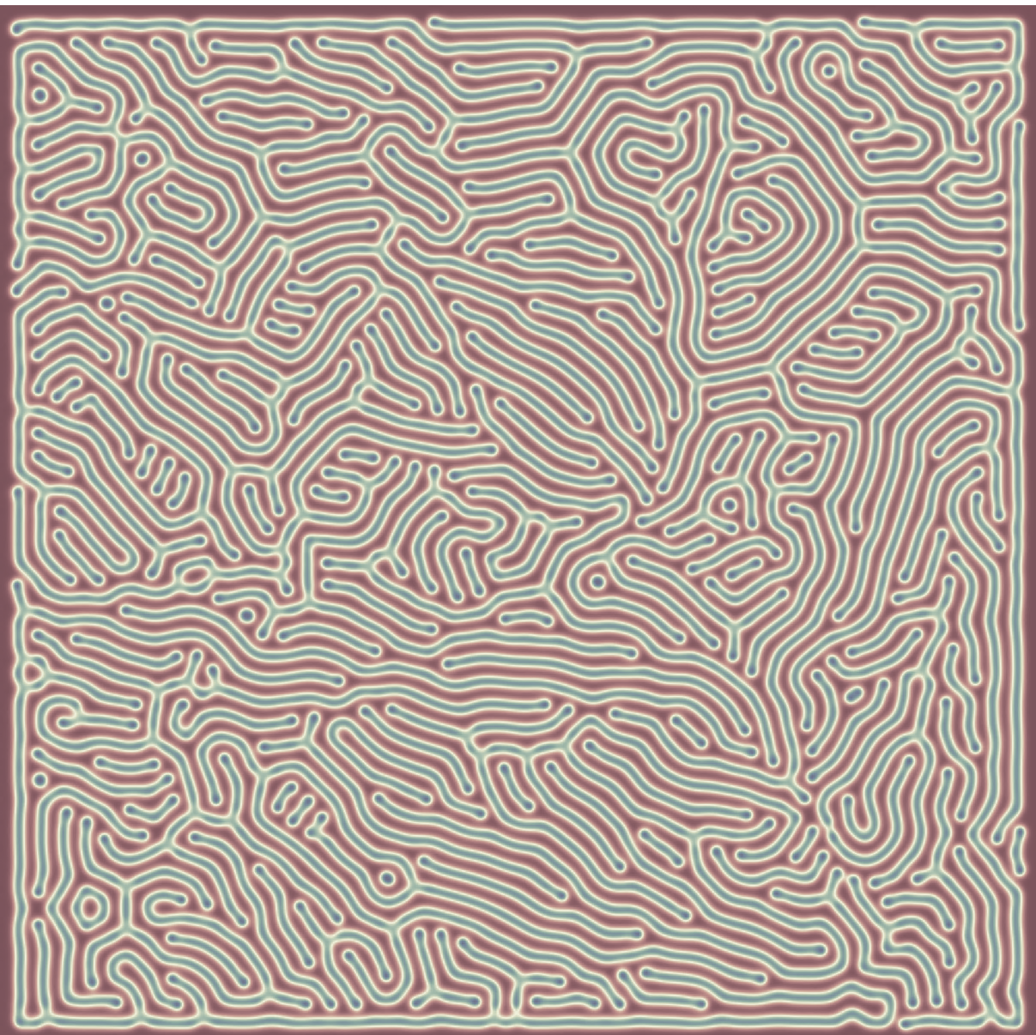

Notes:
kickstarter

Slide 6


Slide 7
Notes:
cover_background_narrow

Slide 8
Notes:
cover_background_wide

Slide 9
Join us for a tour of biological modeling
Biological Modeling
A Short Tour
Compeau
Biological Modeling: A Short Tour offers readers a deep but concise exploration of topics in modeling biological systems at multiple scales of cellular and molecular resolution.
Each chapter poses a single biological question, from why zebras have stripes, to how bacteria explore their world intelligently, to why the SARS-CoV-2 spike protein was so effective at binding to human cells. It then introduces the modeling concepts needed to answer these questions.
The book website (biologicalmodeling.org) provides a free online course containing dozens of interactive tutorials allowing readers to build and explore the models introduced in this book. The course was produced with the help of talented students at Carnegie Mellon University who appear in this book as chapter co-authors.
Biological Modeling A Short Tour
Phillip Compeau, Ph.D. is an Associate (Teaching) Professor in the Computational Biology Department at Carnegie Mellon University. He is the founder of scalable online education projects that have reached over a million learners worldwide.
Philomath Press
Phillip Compeau

Slide 10
Join us for a tour of biological modeling
Biological Modeling
A Short Tour
Compeau
Biological Modeling: A Short Tour offers readers a deep but concise exploration of topics in modeling biological systems at multiple scales of cellular and molecular resolution.
Each chapter poses a single biological question, from why zebras have stripes, to how bacteria explore their world intelligently, to why the SARS-CoV-2 spike protein was so effective at binding to human cells. It then introduces the modeling concepts needed to answer these questions.
The book website (biologicalmodeling.org) provides a free online course containing dozens of interactive tutorials allowing readers to build and explore the models introduced in this book. The course was produced with the help of talented students at Carnegie Mellon University who appear in this book as chapter co-authors.
Biological Modeling A Short Tour
Phillip Compeau, Ph.D. is an Associate (Teaching) Professor in the Computational Biology Department at Carnegie Mellon University. He is the founder of scalable online education projects that have reached over a million learners worldwide.
Philomath Press
Phillip Compeau
Notes:
full_cover_revised

Slide 11
Join us for a tour of biological modeling
Biological Modeling
A Short Tour
Compeau
Biological Modeling: A Short Tour offers readers a deep but concise exploration of topics in modeling biological systems at multiple scales of cellular and molecular resolution.
Each chapter poses a single biological question, from why zebras have stripes, to how bacteria explore their world intelligently, to why the SARS-CoV-2 spike protein was so effective at binding to human cells. It then introduces the modeling concepts needed to answer these questions.
The book website (biologicalmodeling.org) provides a free online course containing dozens of interactive tutorials allowing readers to build and explore the models introduced in this book. The course was produced with the help of talented students at Carnegie Mellon University who appear in this book as chapter co-authors.
Biological Modeling A Short Tour
Phillip Compeau, Ph.D. is an Associate (Teaching) Professor in the Computational Biology Department at Carnegie Mellon University. He is the founder of scalable online education projects that have reached over a million learners worldwide.
Philomath Press
Phillip Compeau
Notes:
full_cover_versa_template

Slide 12
Join us for a tour of biological modeling
Biological Modeling
A Short Tour
Compeau
Biological Modeling: A Short Tour offers readers a deep but concise exploration of topics in modeling biological systems at multiple scales of cellular and molecular resolution.
Each chapter poses a single biological question, from why zebras have stripes, to how bacteria explore their world intelligently, to why the SARS-CoV-2 spike protein was so effective at binding to human cells. It then introduces the modeling concepts needed to answer these questions.
The book website (biologicalmodeling.org) provides a free online course containing dozens of interactive tutorials allowing readers to build and explore the models introduced in this book. The course was produced with the help of talented students at Carnegie Mellon University who appear in this book as chapter co-authors.
Biological Modeling A Short Tour
Phillip Compeau, Ph.D. is an Associate (Teaching) Professor in the Computational Biology Department at Carnegie Mellon University. He is the founder of scalable online education projects that have reached over a million learners worldwide.
Philomath Press
Phillip Compeau
Notes:
full_cover_versa

